Slide 1

Android Apps & You
Madhulika Chilla
Jason Crawford
Mrinmoy Dalal
Chethan Manjunath
MGMT 58600 – Python Programming – Group 1

Slide 2

Introduction
Notes:
Jason: 3-5, 21-24
Mrin: 7 – 11
Chethan: 12 – 15
Madhu: 16 – 20

Slide 3





Introduction and Problem
As of June 2022, Google Play store has >2.5m apps and >100b downloads per year
Most of those apps have little to no installs
Given a target of maximizing downloads and/or review score, what are the best practices to do so?
Free vs Paid
Category
Update Support
Et Al
Why not focus on potential earnings?
All Logos are trademarks of their respective owners

Slide 4
Dataset
googleplaystore.csv – primary dataset
googleplaystore_user_reviews.csv – secondary dataset

Slide 5
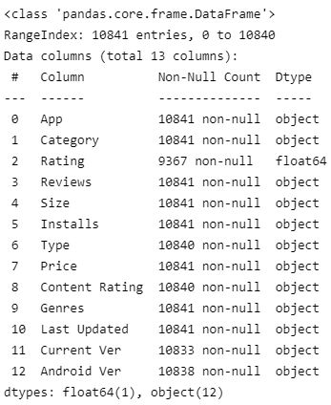

Description and Limitations of Dataset
Description:
Dataset Limitations
Unable to capture financial impact of ad-revenue
Assumption of a truly random sample
Data circa 2018
Number of Unique Apps: 9660

Slide 6
Data Cleansing

Slide 7
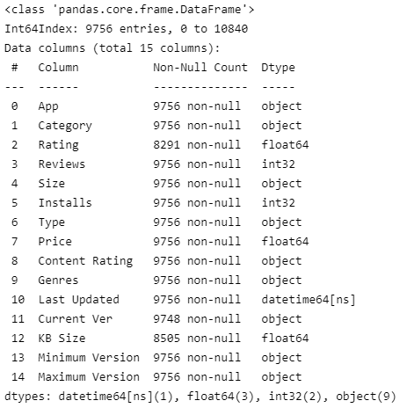
Steps of Data Cleaning
Handle NA values
Cleanse garbage values/data
Cast to Appropriate Datatypes
Calculate derived attributes
Eliminate of Duplicate Rows

Slide 8
Data Exploration

Slide 9
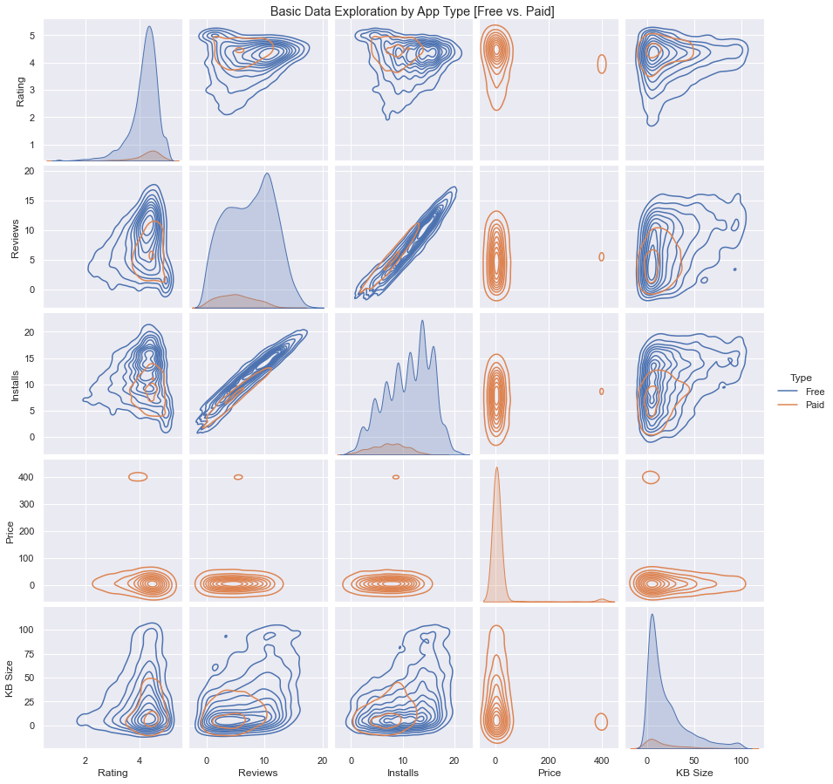
Basic Analysis
A basic exploratory analysis using pairplot function within seaborn to look for any evident patterns or relationships between the features in the dataset
Applied a Kernel Density Estimate (KDE) to estimate the probability density function and view the data distribution

Slide 10
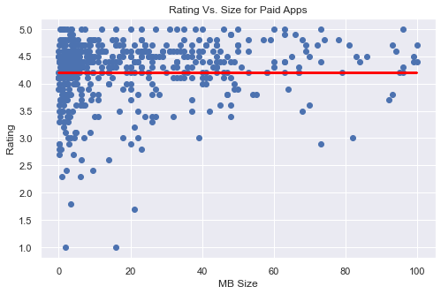
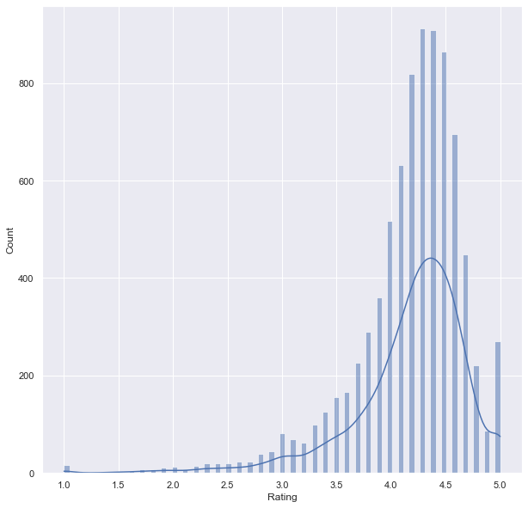
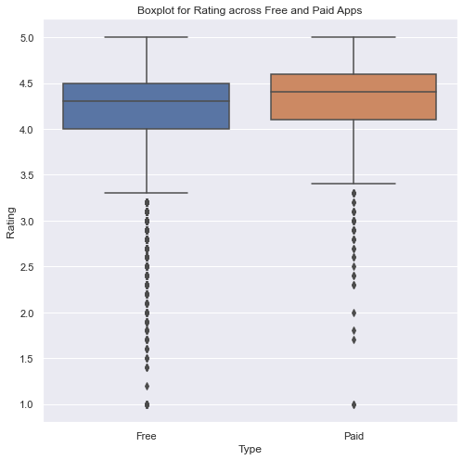
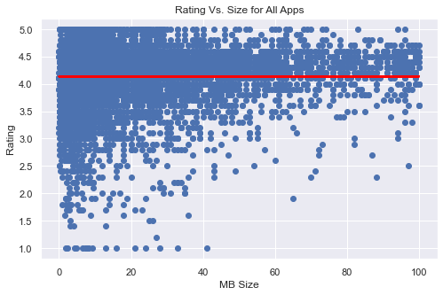
Analysis on Play Store Ratings
Average app rating on the Play Store is: 4.17 which is relatively high indicating that the Play Store is faring relatively well
Paid apps have marginally higher median rating when compared to their free counterparts
Very little correlation between size of apps and ratings

Slide 11
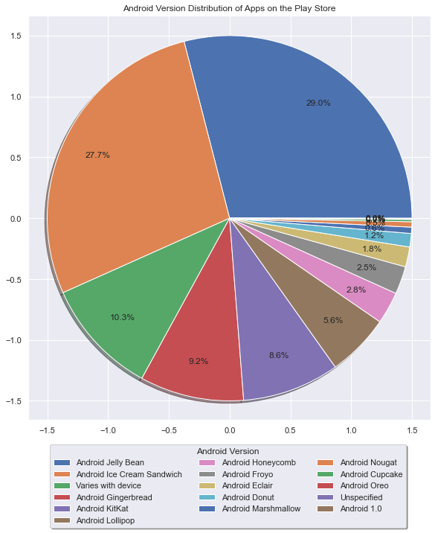
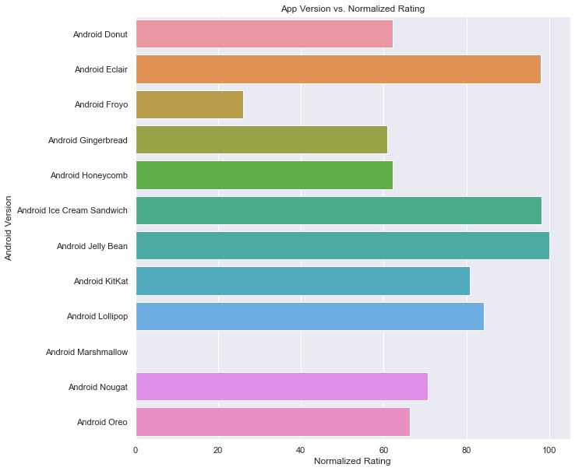
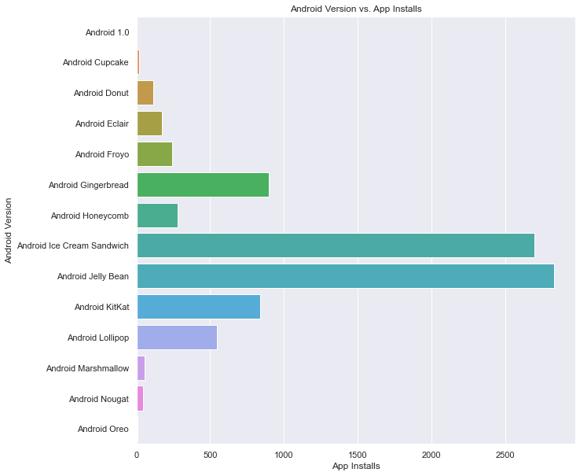
Analysis on Android Version
Apps written for Android Ice Cream Sandwich and Jelly Bean enjoy higher ratings.
Users prefer installing applications that are written for Android Ice Cream Sandwich and Jelly Bean and up
Majority of the apps are written for Android Ice Cream Sandwich and Jelly Bean

Slide 12
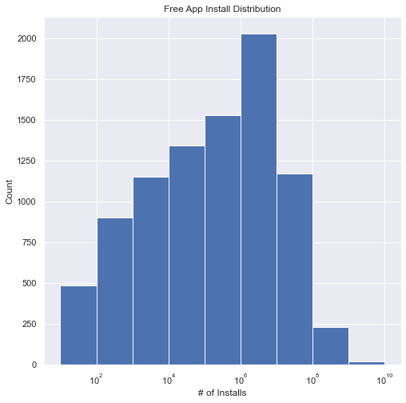
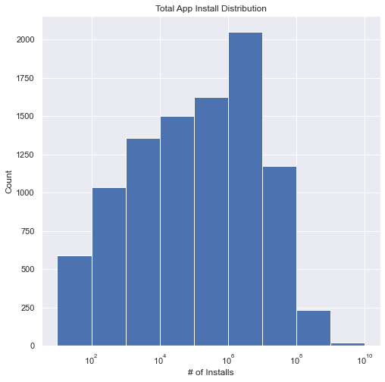
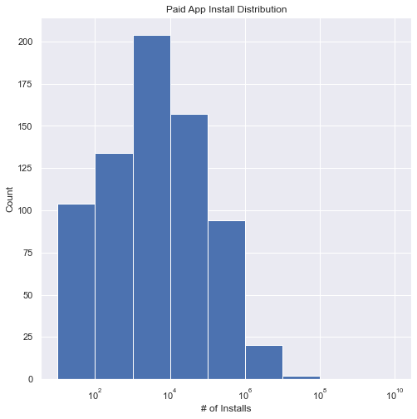


Analysis on Play Store Installs – Dist.
Note the difference in scale between and free and paid apps

Slide 13
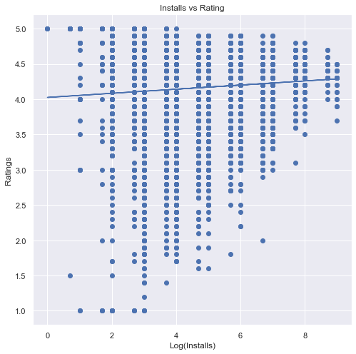
Analysis on Play Store Installs vs Rating
As expected, positive correlation between log of installs and ratings
However, not especially strong relationship

Slide 14
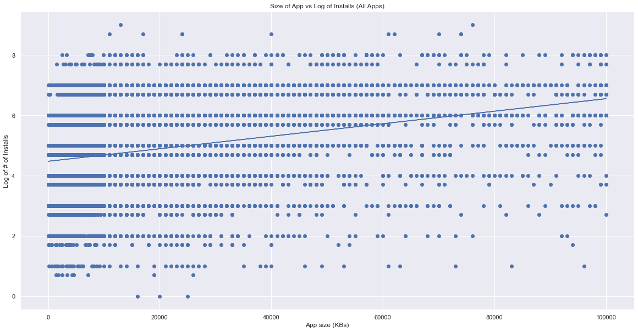
Analysis on Play Store Installs vs Size
Why the positive relationship?

Slide 15
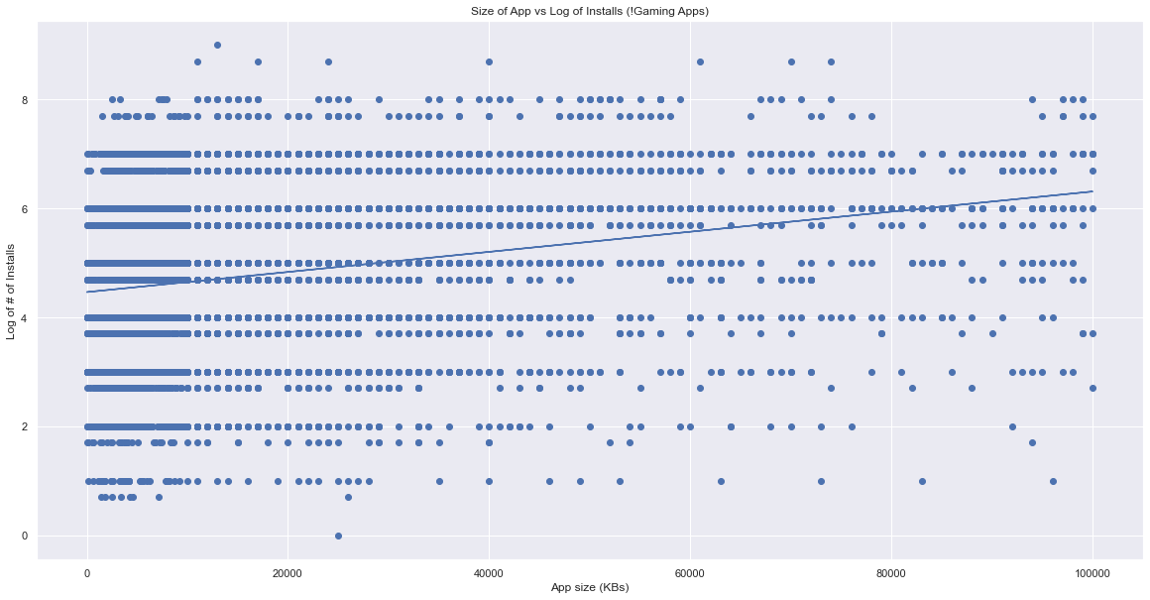
Analysis on Play Store Installs vs Size
Relationship holds within subset of just games, suggesting relationship between size and installs isn’t just that games tend to be larger in size

Slide 16
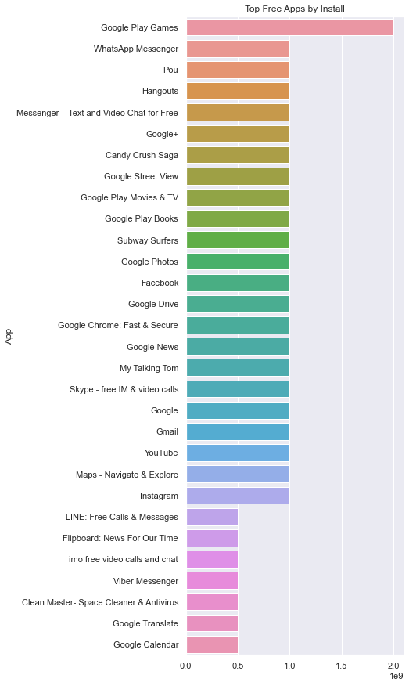
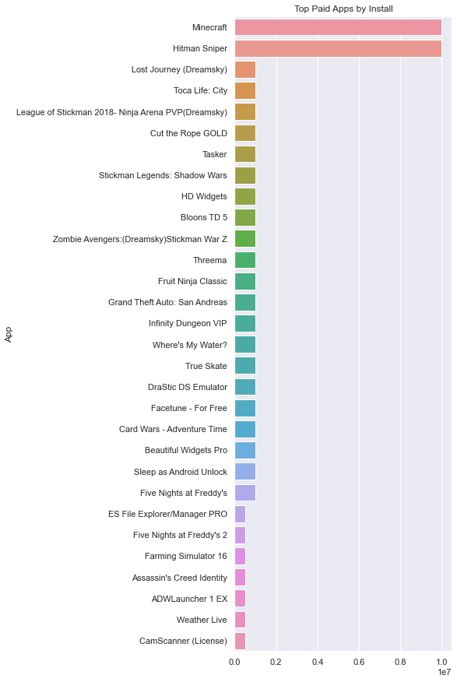
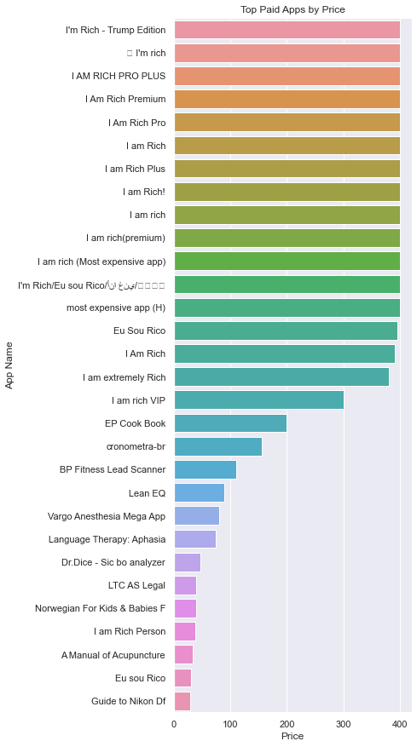
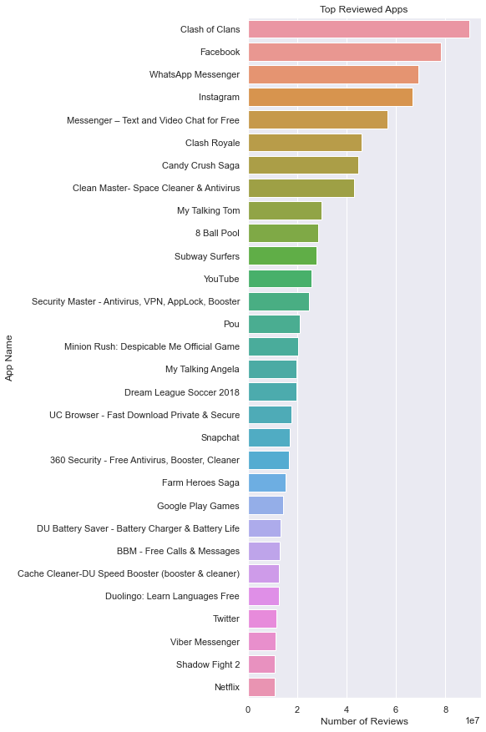
Exploration of Top Play Store Apps
The bigger and more known players dominate the Play Store in terms of reviews, installs and ratings.
Top paid apps “I am Rich” are the android spoofs of the infamous iPhone app, that serve no purpose except for boasting to friends and burning money

Slide 17
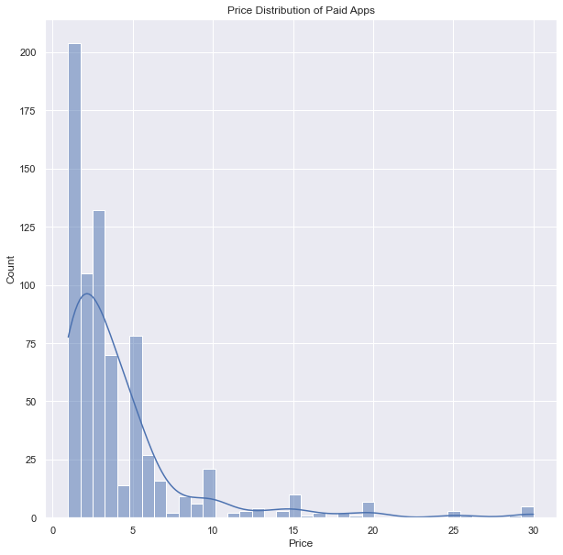
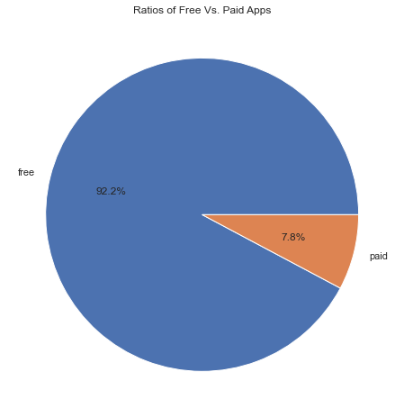
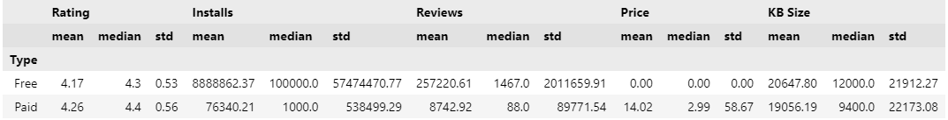
Effect of Price
Paid apps mostly target niches and free apps are more likely to be popular with users.
Unsurprisingly, most developers focus their efforts on providing free apps, and tend to monetize their apps via other channels.
Even within paid apps, majority of the apps are priced between $0.99 and $9.99.
Apps that are higher priced may not perform well.

Slide 18
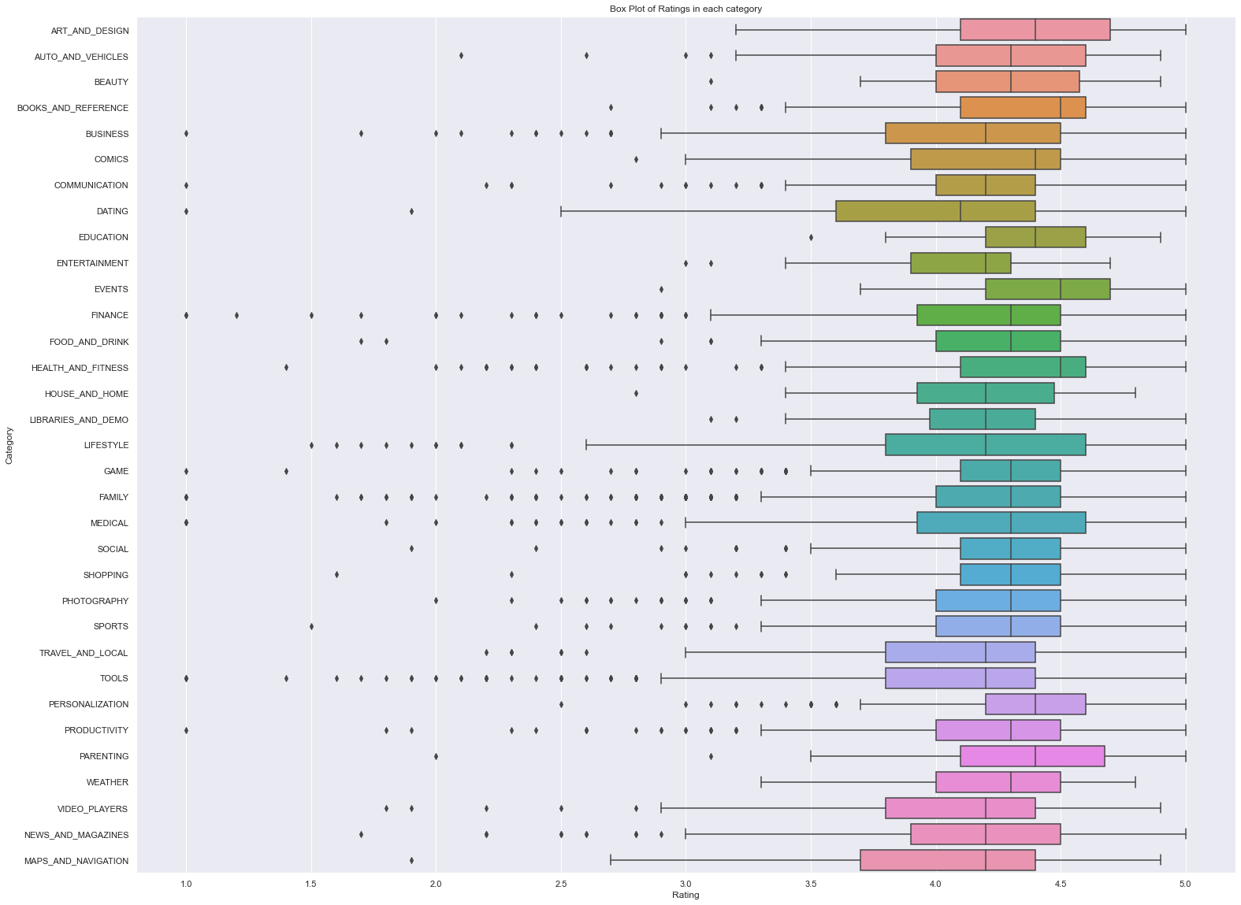
Exploration of App Categories
Some categories have much wider distribution (Dating & Lifestyle)
Virtually all categories have medians between 4.0 and 4.5
Books, Health & Fitness, and Events have highest medians

Slide 19
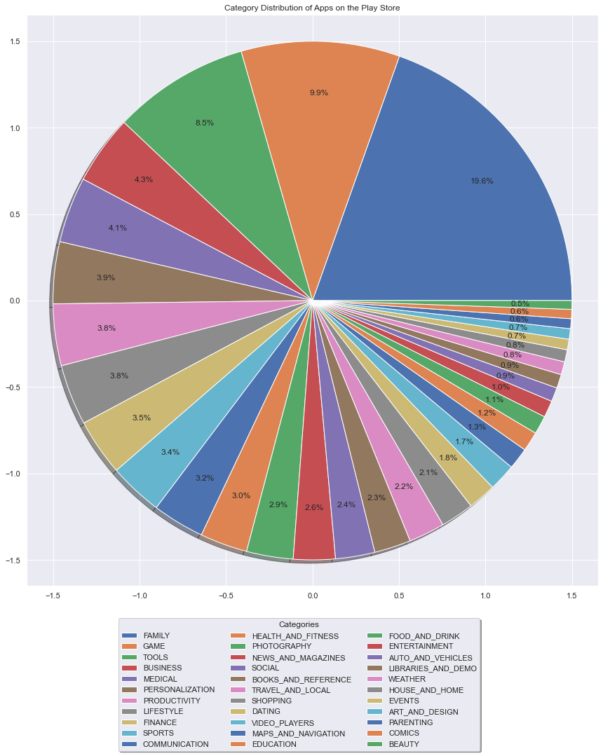
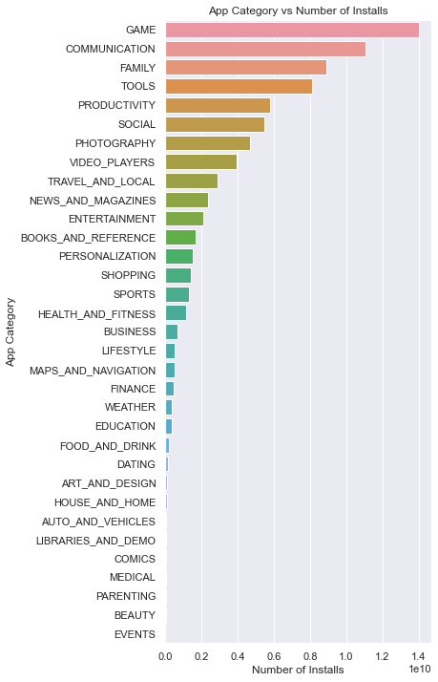
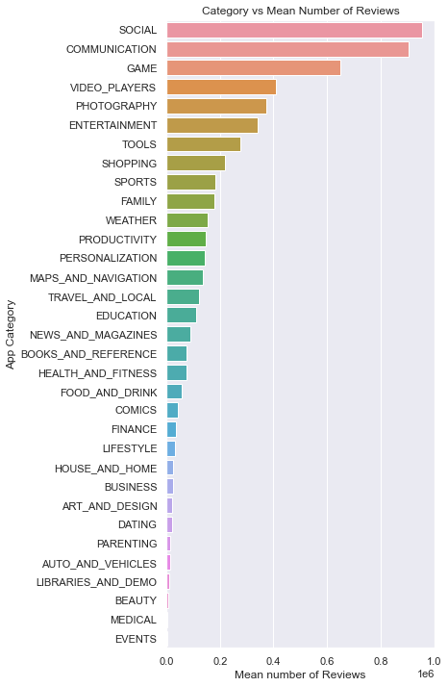
Exploration of App Categories
Family and Game categories have the highest number of apps on the play store and unsurprisingly, game apps have the highest number of installs. Since social and communication apps involve lot of user interaction, it is clear why they have the highest mean reviews out of the apps on the Play Store

Slide 20
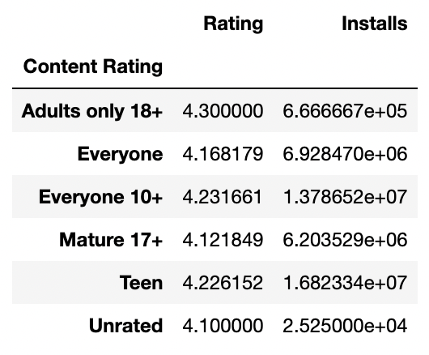
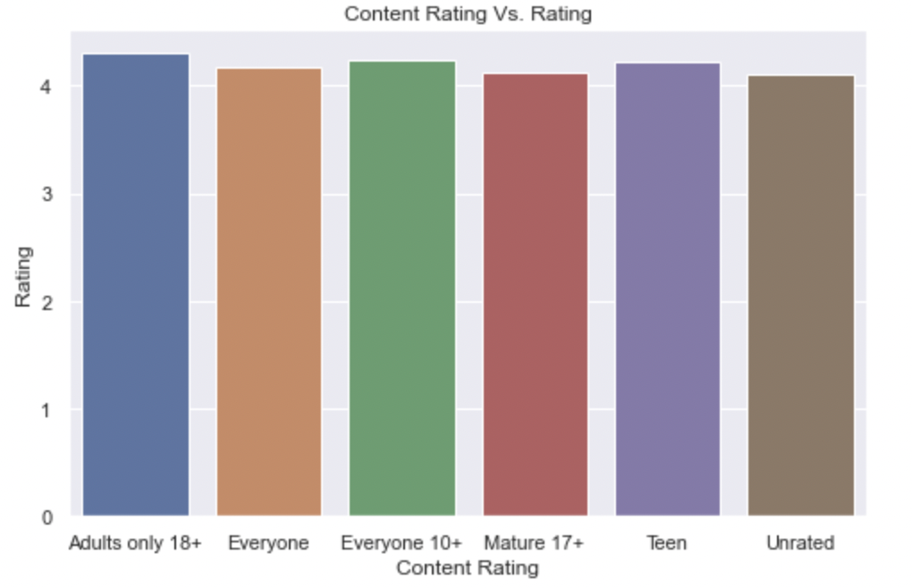
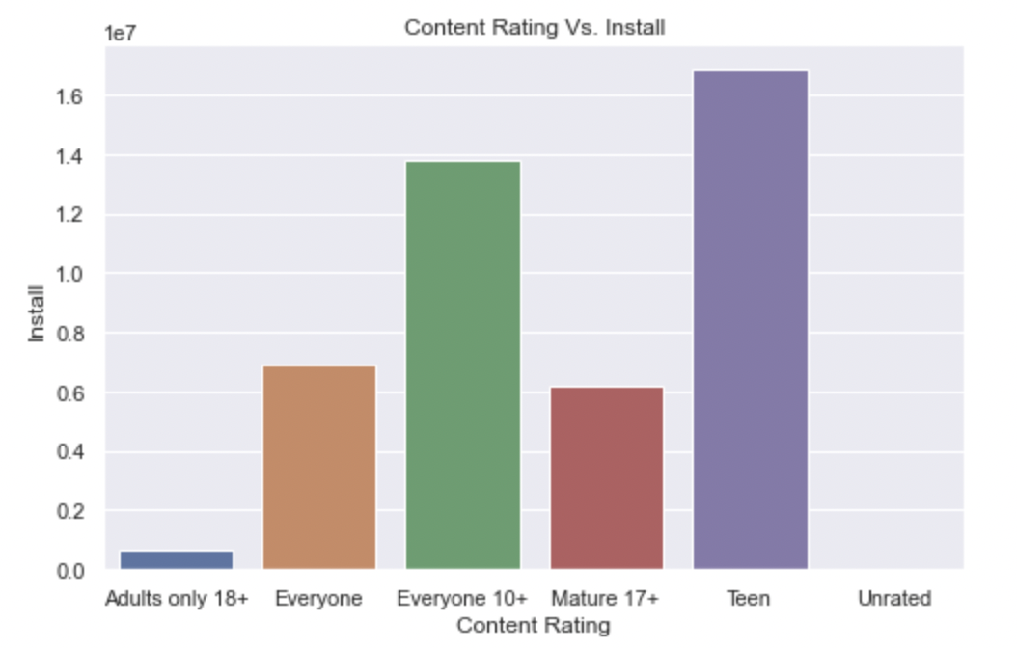
Impact of Content Rating on Rating and Installs
There is no significant difference in rating of an app across content ratings, however the content rating can ding the number of installs a particular app may receive.
From this preliminary analysis, developers should choose to create apps that are not age restricted

Slide 21
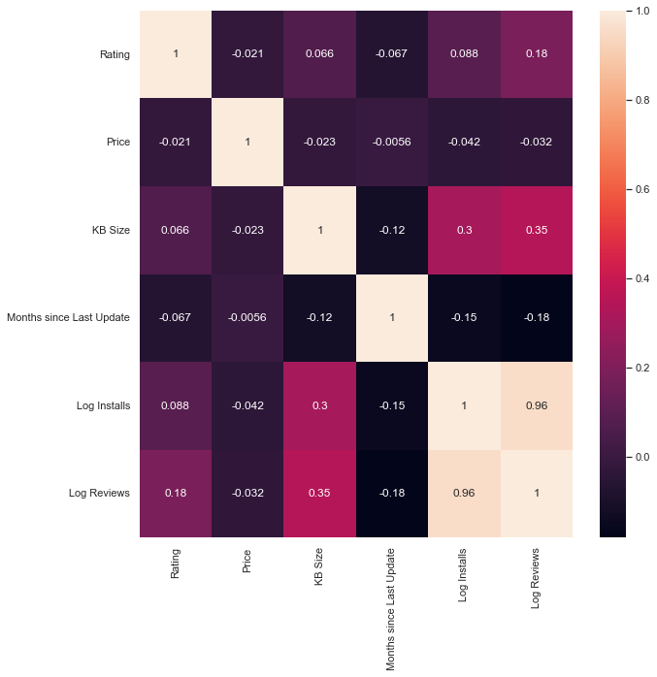
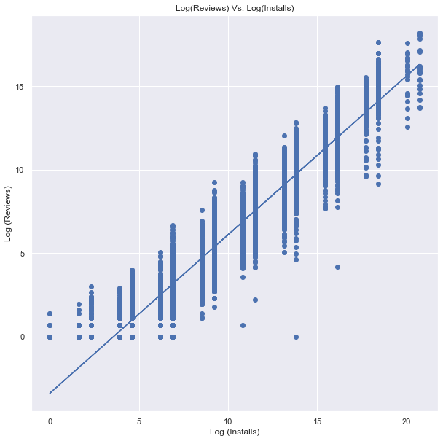
Correlation between Dataset variables
Reviews and Installs have a strong positive correlation which means that good reviews tend to attract more users resulting in increase in number of installations.

Slide 22
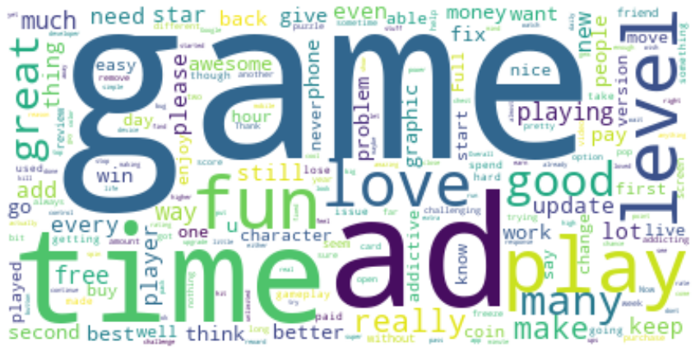
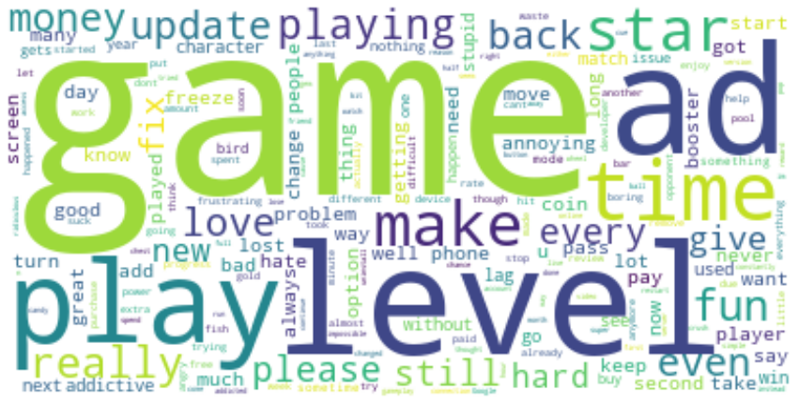
Word Clouds on User Sentiment - Gaming
Positive Reviews
Negative Reviews

Slide 23
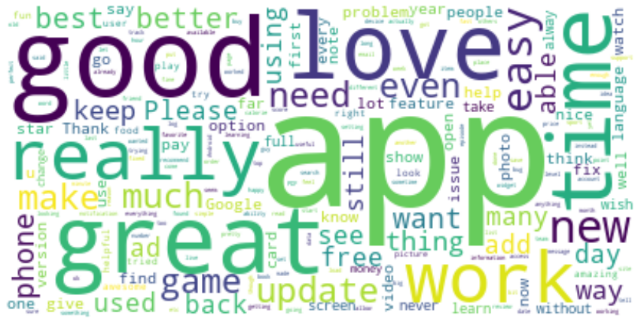
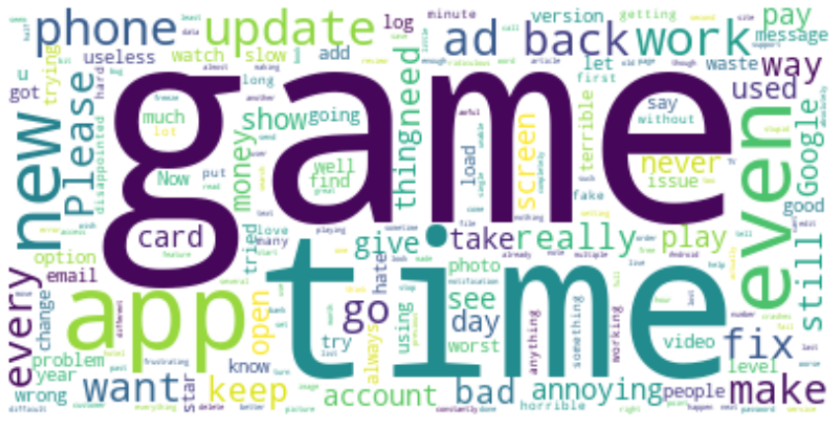
Word Clouds on User Sentiment - Other
Positive Reviews
Negative Reviews

Slide 24
So, what have we learned?

Slide 25

Best Practices
Free Apps dramatically outperform Paid Apps on # of installs, and honestly are comparable on reviews
You don’t need to support ancient Android versions
Gaming and Communication Apps outperform on installs
Adult Only Content <> High Install Base
Update your app reasonably regularly
# of Installs is a heavily right-skewed distribution, so understand the difference between mean and median when setting expectations

Slide 26
Questions?

Slide 27
Thank You!
Madhulika Chilla
Jason Crawford
Mrinmoy Dalal
Chethan Manjunath

